Slide 1


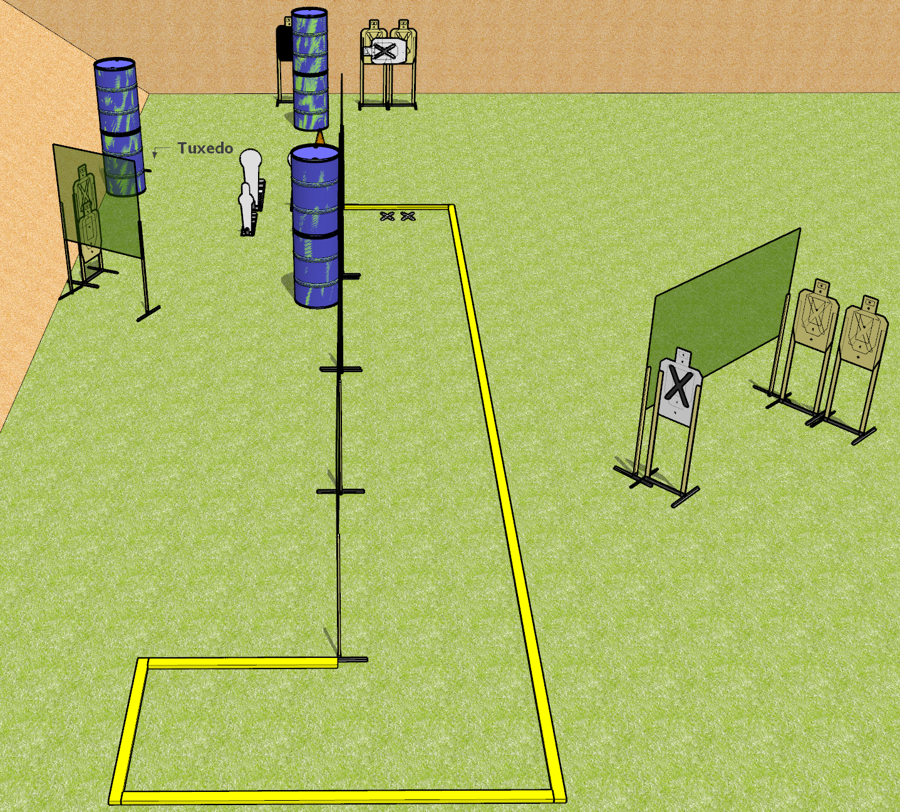
 | Dothan Gun Club – USPSA Match Run Away Course Designer : Drew Coleman
START POSITION : Standing with both feet on X’s, wrists below belt
GUN READY CONDITION : Pistol loaded and holstered. PCC loaded, shouldered, muzzle pointed at cone. |  | SCORING: Comstock, 20 rounds TARGETS: 8 paper, 4 Steel SCORED HITS: Best 2 on paper, steel until down START-STOP: Audible, last shot RULES:
STAGE PROCEDURE: Engage targets as they become available from within the fault lines.

Slide 2
Run Away
Written Stage Briefing
Run Away is a 20 round, 100 point, Comstock Medium Course. There are eight USPSA targets, two Colt Speed Steel poppers, and two mini poppers. The best two hits per target will score. Steel must fall to score. The start signal is audible.
Handgun start position is feet on X’s, wrists below belt. Handgun is loaded and holstered
PCC start position is feet on X’s, loaded carbine held in both hands, safety on, shouldered, muzzle pointed at cone.
Upon start signal, engage targets as they become available from within the shooting area.

